Slide 1
CHIKV Macrodomain fragment screen
Jasmin Aschenbrenner and Daren Fearon (XChem)
Diamond Light Source

Slide 2
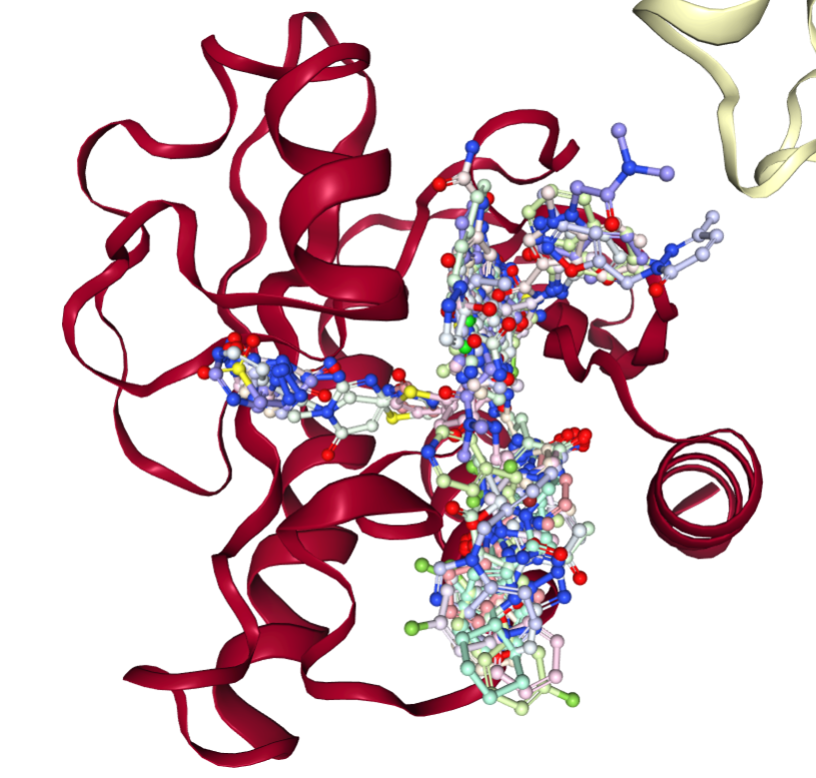
Crystallographic fragment screen – progress
Fragments soaked: 1385 (DSi-Poised Library, Minifrags, Fraglites, Peplites, York 3D, SpotXplorer, Enamine Essential Fragments)
Datasets successfully collected and processed: 1082 datasets
Hit identification: 113 fragment hits (66 in active site, 47 in sub-sites close to the active site)
PoseButcher analysis:
Ribose-binding site: 42
Phosphate-binding site: 26
Oxyanion site: 61
Adenine site: 188

Slide 3
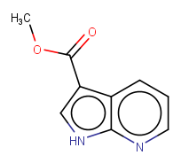
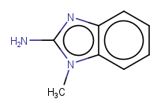
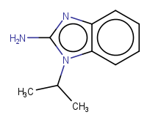
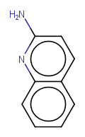
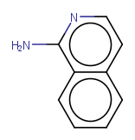
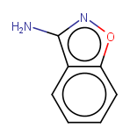
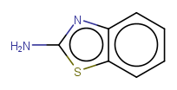
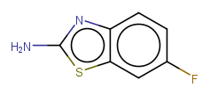
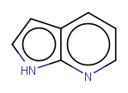
Adenine site fragments – hinge binders
Aminoquinoline/
benzoxazole
Pyrrolo
pyridine
Amino benzimidazole/ benzothiazole
x1203
x1299
x1278
x1440
x1338
x1288
x1271
x1410
x1402

Slide 4
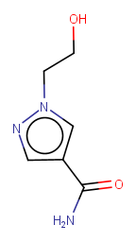
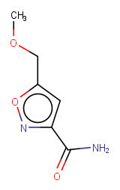
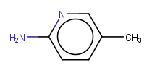
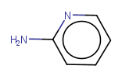
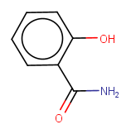
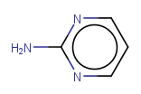
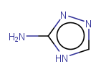
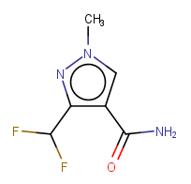
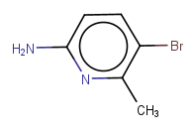
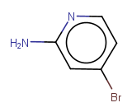
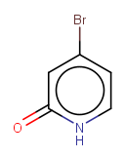
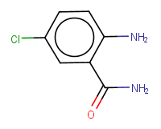
Adenine site fragments – hinge binders
Aminopyridine like
Amides
x1406
x1116
x1445
x0477
x0404
x1132
x1123
x1454
x1075
x1076
x0394
x1372

Slide 5
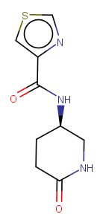
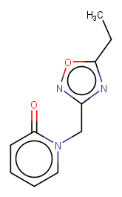
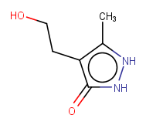
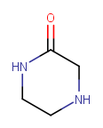
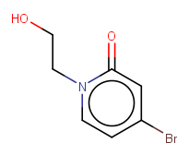
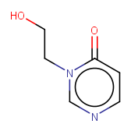
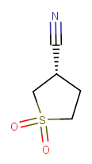
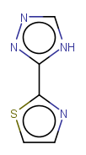
Other sites
Oxyanion hole
x0300
x0316
x0317
x1131
x1091
x0314
Phosphate groove – ribose site
x1182
x0281

Slide 6
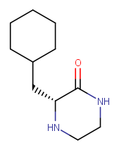
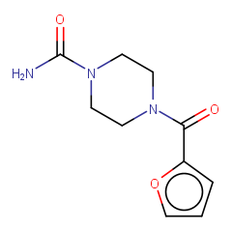
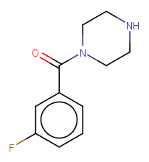
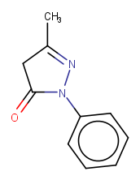
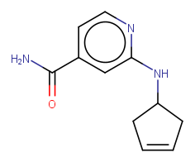
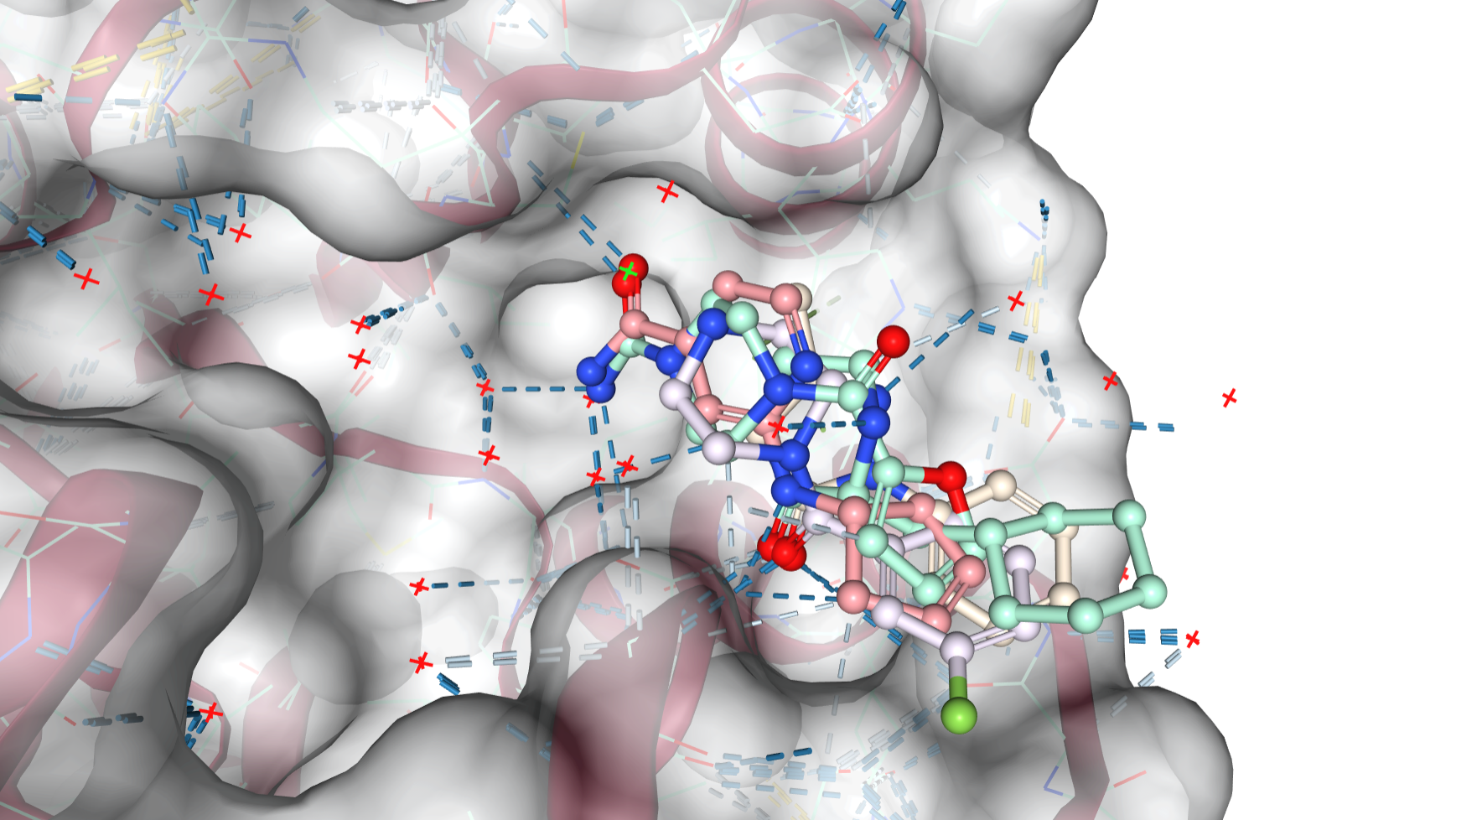
Potential protac starting points
x0436
x0441
x0543
x0585
x0760

Slide 7
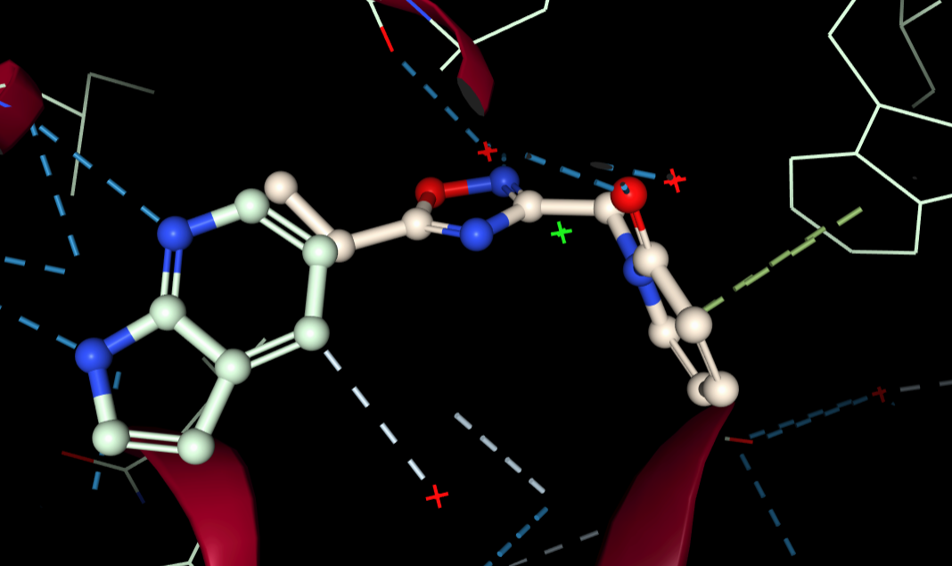
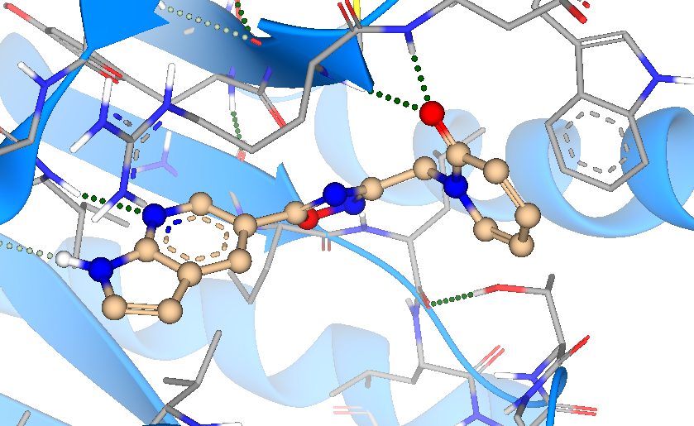
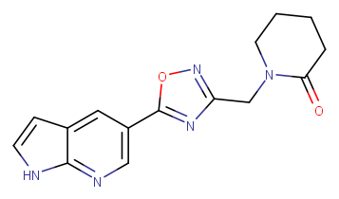
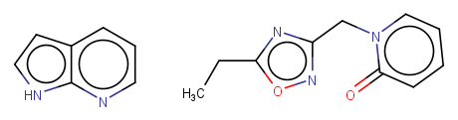
Potential merges
x1402 (adenine site) + x0316 (oxyanion hole)
CHIKVMac-DLS-DF001

Slide 8
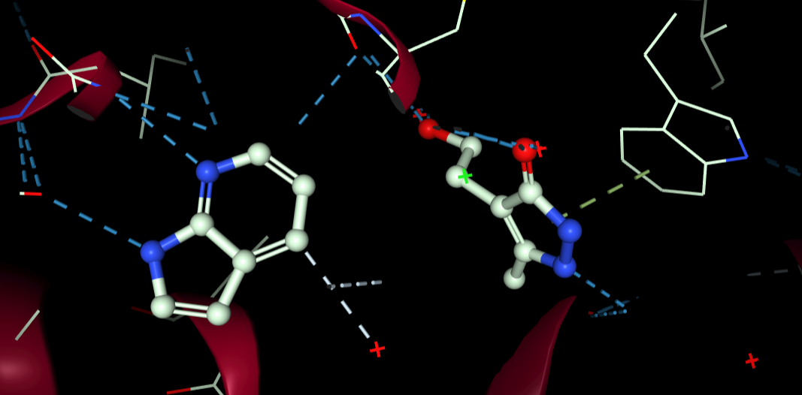
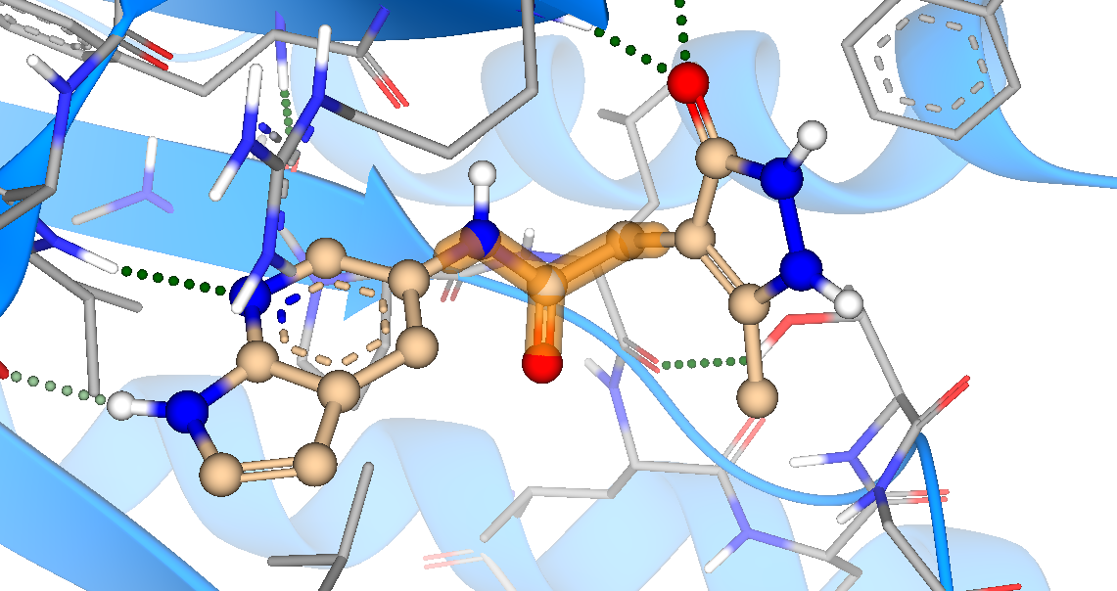
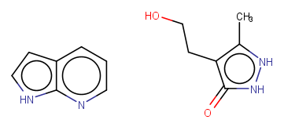
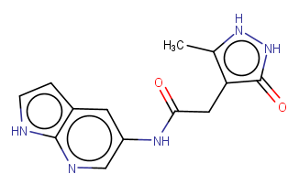
Potential merges
x1402 (adenine site) + x0317 (oxyanion hole)
CHIKVMac-DLS-DF002

Slide 9
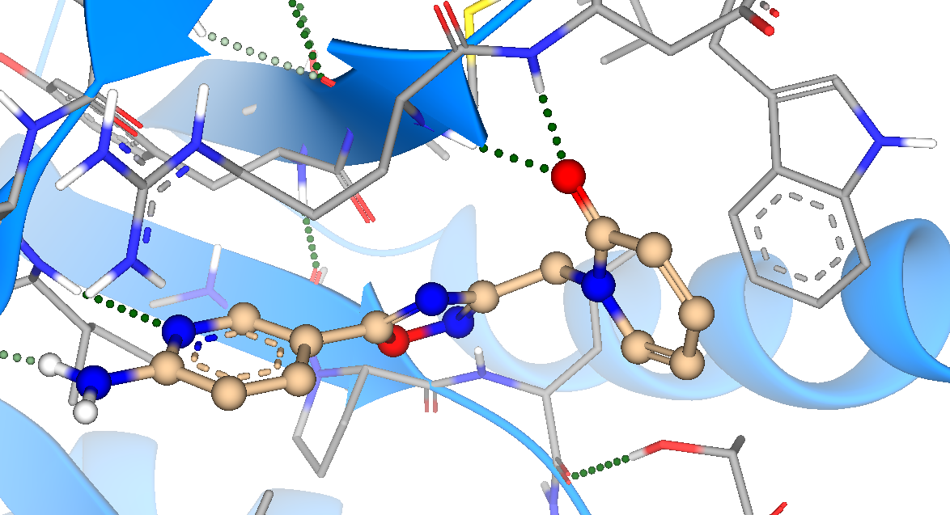
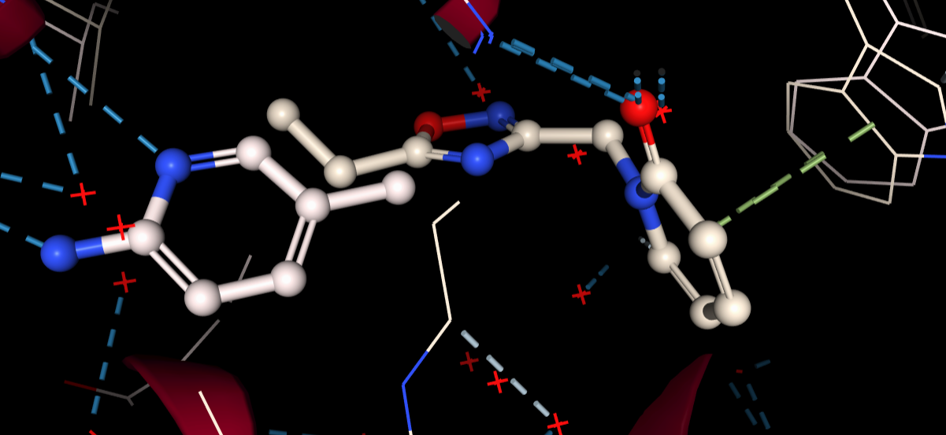
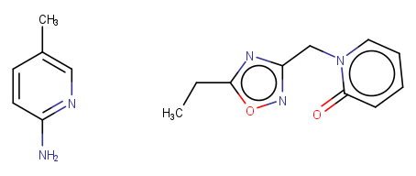
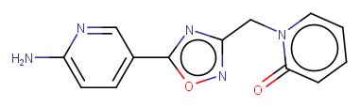
Potential merges
x1406 (adenine site) + x0316 (oxyanion hole)
CHIKVMac-DLS-DF003

Slide 10
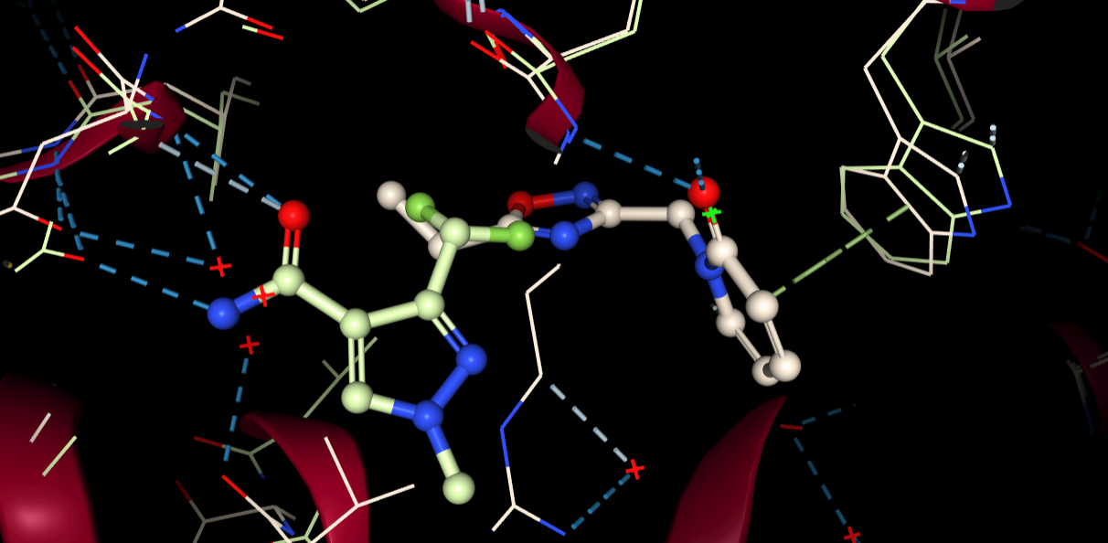
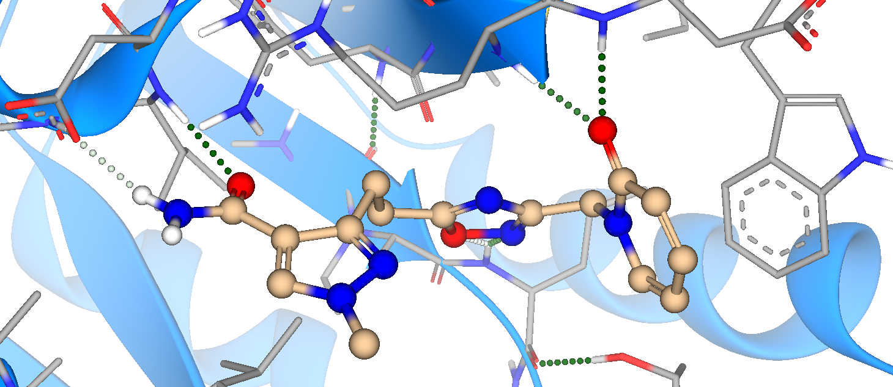


Potential merges
x0394 (adenine site) + x0316 (oxyanion hole)
CHIKVMac-DLS-DF004

Slide 11




Potential merges
x1203 (adenine site) + x0892 (phosphate site)
CHIKVMac-DLS-DF005

Slide 12




Potential merges (by Jasmin)
x0892 (adenine site) + x0281 (phosphate site)
CHIKVMac-DLS-JA001

Slide 13




Potential merges (by Jasmin)
x0281 (phosphate site) + x0406 (adenine site)
CHIKVMac-DLS-JA002

Slide 14





Potential merges (by Jasmin)
x0316 (oxyanion hole) + x0441 (Trp148 site)
CHIKVMac-DLS-JA003

Slide 15




Potential merges (by Jasmin)
x1114 (ribose site) + x0314 (phosphate site)
CHIKVMac-DLS-JA004

Slide 16




Potential merges (by Jasmin)
x1182 (ribose site) + x0314 (phosphate site)
CHIKVMac-DLS-JA005

Slide 17



Potential merges (by Jasmin)
x1182 (ribose site) + x0281 (phosphate site)
CHIKVMac-DLS-JA006

Slide 18




Potential merges (by Jasmin)
x1135 (ribose site) + x0281 (phosphate site)
CHIKVMac-DLS-JA007

Slide 19




Potential merges (by Jasmin)
x0289 (Arg144 site) + x0892 (phosphate site)
CHIKVMac-DLS-JA008

Slide 20


Potential merges (by Jasmin)
x0289 (Arg144 site) + x0892 (phosphate site)
CHIKVMac-DLS-JA009

